Slide 1

Notes:
Surveyors design, value and manage everything you see. Pretty bold statement but if you can give me an example of some a building or a piece of land, then a surveyor works on it.
Who has a favourite place? Who likes to go to the cinema? Who likes to play sports or go to the gym? Those spaces and buildings are

Slide 2
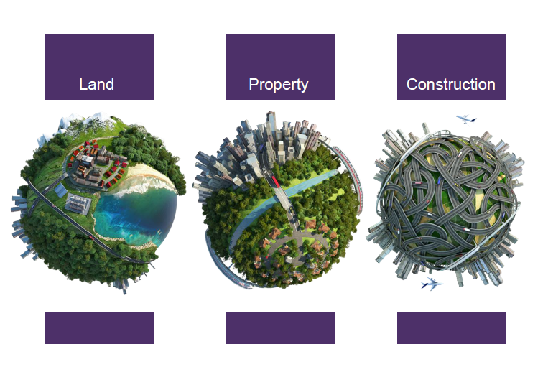
Notes:
ES / CR

Slide 3
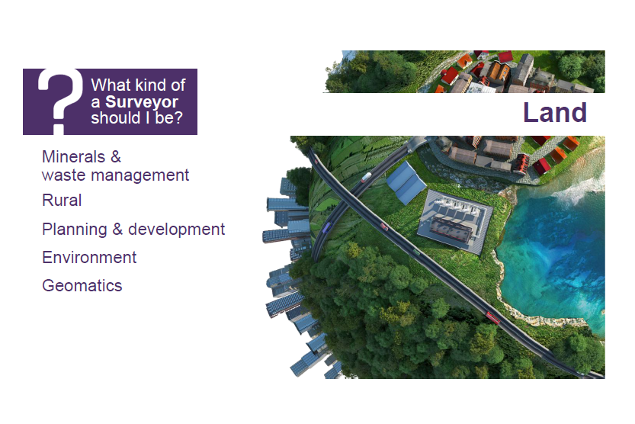
Notes:
Land if you want to be out in the countryside, on a farm or estate. Looking at the countryside or the sea bed. Understanding natural resources and what their value is, how they can best be managed, bought or sold.

Slide 4
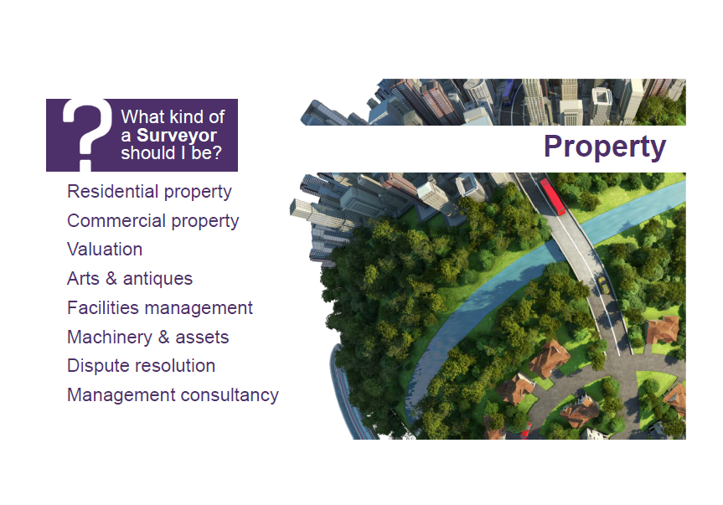
Notes:
You might consder the property pathway if you are interested in assets – rather than trading in stocks, shares or precious metals you could be advising clients to buy millions of pounds worth of real estate whether that’s a flat, a block of flats, a stately home or an office, shop....do you think you could convince someone to buy the SHARD?????

Slide 5
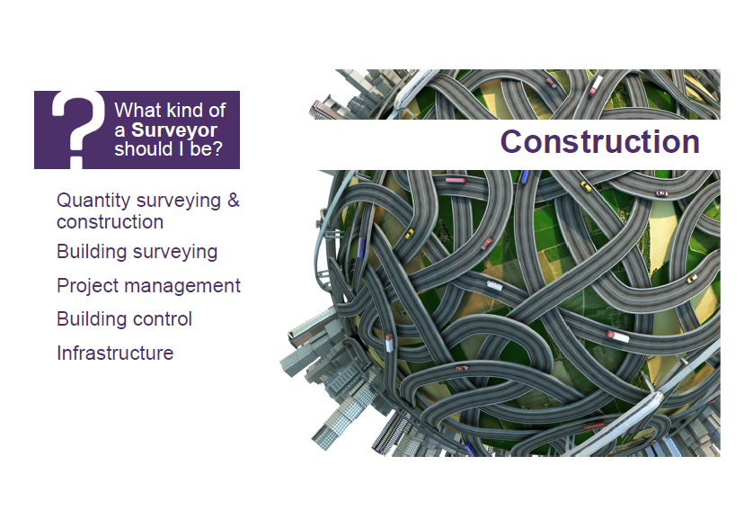
Notes:
Then there’s construction – understanding how things are built, what they are made of – what should they be priced at, when will this bridge fall down, and how can we stop it doing that???

Slide 6
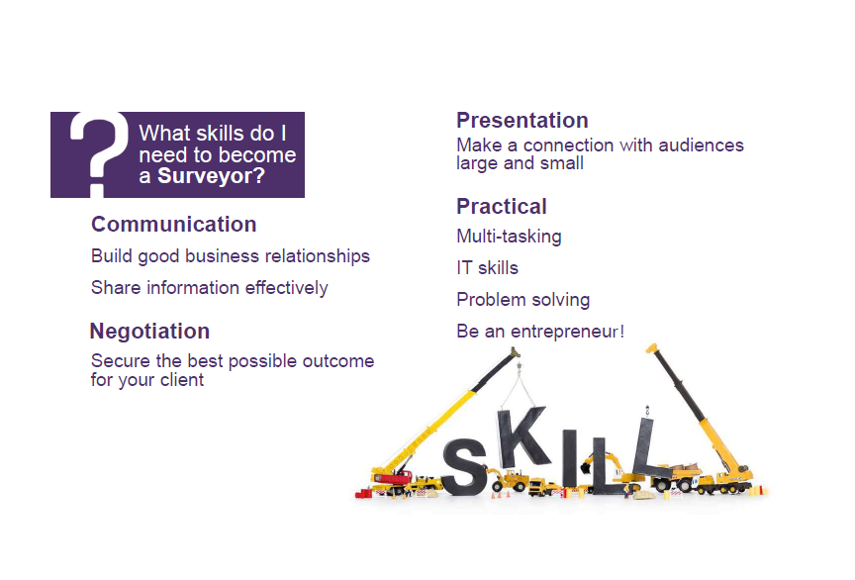
Notes:
Overview of what makes a good surveyor

Slide 7

Degree Apprenticeships
Straight from school
Working 4 days per week
Study one day per week
4 year degree
Then professional qualification
No debt
Earn while you learn
6 years to qualification MRICS
Notes:
Please talk about these bullet points
Describe the work you do day to day
Is the studying difficult or different than you would expect from a degree
Do you enjoy it
What is the industry like to work in?

Slide 8

Graduate Programme/Sandwich Placements
University first (Real Estate or non property course then masters)
2 years training programme (APC)
Sandwich placements
Day to day experience
Professional qualification
Support
Careers
Notes:
Please talk about these bullet points
Describe the work you do day to day
Do you enjoy it
What is the industry like to work in?

